Slide 1
Western Australian Curriculum: Technologies

Slide 2
What is Mandated?
Curriculum content
Principles of Teaching, Learning and Assessment
Achievement Standards
Reporting student achievement

Slide 3
Achievement Standard
The achievement standard describes an expected level that the majority of students are achieving or working towards by the end of a given year of schooling. Some students will have progressed beyond the achievement standard; others will need additional support.

Slide 4
STEM Clarifications
STEM
is not a learning area but a pedagogy and a body of knowledge that relates to many different learning areas
does not replace the teaching of Mathematics, Technologies, Engineering or Science as published in the Outline
provides opportunities for integration
can provide for the use of everyday materials and contexts for activities and assessments
The Western Australian curriculum for Science, Technologies, Engineering and Mathematics is mandated with clear reporting requirements.

Slide 5
Technologies
The Technologies curriculum is written on the basis that all students will study both Technologies subjects from Pre-primary to Year 10:
Design and Technologies
Students have the opportunity to study at least one context
Digital Technologies

Slide 6
Notional Times
guidelines developed to assist schools and teachers to plan for and make decisions about how the curriculum is implemented
the curriculum is mandated; students need to be given adequate time in their timetable to cover the curriculum and allow for meaningful assessment
*Learning areas not mandated after Year 8
** ‘Unallocated time’ would actually be greater than shown, depending on the number of hours of teaching per week at each school

Slide 7
WA Curriculum: Technologies

Slide 8
Sample
Teaching and Learning Outlines

Slide 12
Context: Food and fibre production - Year 1

Slide 13
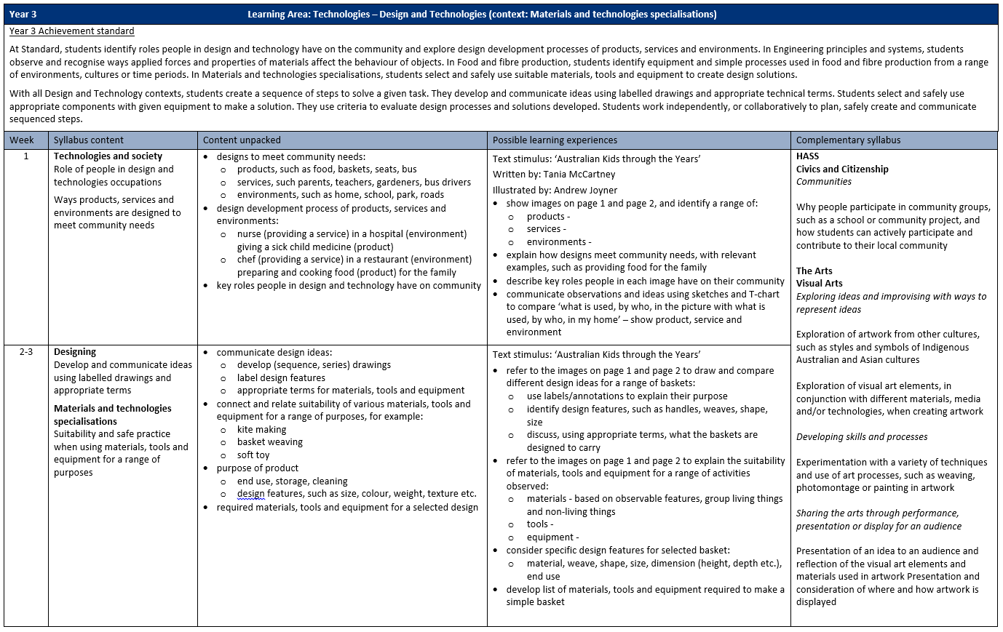

Slide 14
Assessment
Assessments need to:
align with the curriculum
utilise a variety of strategies
Schools must provide their school community with an assessment and reporting policy that is based on the Principles of Teaching, Learning and Assessment.
Pre-primary to Year 10: Teaching, Assessing and Reporting Policy p. 3

Slide 15
Assessment Pointers
Assessment pointers are used for validating teachers’ professional judgement when reporting against a five-point scale.
The pointers are:
examples of evidence in relation to the achievement standard;
should be used with the annotated work samples and,
exemplify what students may demonstrate rather than a checklist of everything they should do.

Slide 16
Assigning a Grade for Reporting
Judging standards is a tool to support teachers:
to report against the achievement standards for each year of schooling
to give feedback on assessment
to explain the difference between one student's achievement and another's.
The grade is derived from the evidence collected across all the assessment tasks, both formative and summative.

Slide 17
Reporting – minimum requirements
In the future, the Authority will require the final grade to be provided for each learning area as described in the reporting policy.
Pre-primary to Year 10: Teaching, Assessing and Reporting Policy p. 13

Slide 18
Copyright
© School Curriculum and Standards Authority, 2019
This document – apart from any third party copyright material contained in it – may be copied for non-commercial purposes in Western Australian schools, and in schools offering the Western Australian Certificate of Education (WACE), provided that the School Curriculum and Standards Authority is acknowledged as the copyright owner.
The document may not be copied for any other purpose. The document ─ including any third party copyright material contained in it ─ must not be communicated to the public on an intranet, an extranet, or an internet site.
Any content in this document that has been derived from the Australian Curriculum may be used under the terms of the Creative Commons Attribution 4.0 International (CC BY) licence.

